Slide 1
Nyquist Stability Criterion
The Nyquist stability criterion is similar to the Bode criterion in that it determines closed-loop stability from the open-loop frequency response characteristics.
The Nyquist stability criterion is based on two concepts from complex variable theory, contour mapping and the Principle of the Argument.
Nyquist Stability Criterion. Consider an open-loop transfer function G_{OL}(s) that is proper and has no unstable pole-zero cancellations. Let N be the number of times that the Nyquist plot for G_{OL}(s) encircles the -1 point in the clockwise direction. Also let P denote the number of poles of G_{OL}(s) that lie to the right of the imaginary axis. Then, Z = N + P where Z is the number of roots of the characteristic equation that lie to the right of the imaginary axis (that is, its number of “zeros”). The closed-loop system is stable if and only if Z = 0.

Slide 2

Some important properties of the Nyquist stability criterion are:
It provides a necessary and sufficient condition for closed-loop stability based on the open-loop transfer function.
The reason the -1 point is so important can be deduced from the characteristic equation, 1 + G_{OL}(s) = 0. This equation can also be written as G_{OL}(s) = -1, which implies that AR_{OL} = 1 and , as noted earlier. The -1 point is referred to as the critical point.
Most process control problems are open-loop stable. For these situations, P = 0 and thus Z = N. Consequently, the closed-loop system is unstable if the Nyquist plot for G_{OL}(s) encircles the -1 point, one or more times.
A negative value of N indicates that the -1 point is encircled in the opposite direction (counter-clockwise). This situation implies that each countercurrent encirclement can stabilize one unstable pole of the open-loop system.

Slide 3


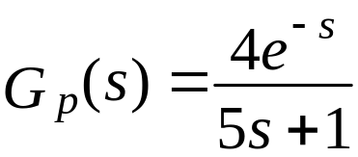
Unlike the Bode stability criterion, the Nyquist stability criterion is applicable to open-loop unstable processes.
Unlike the Bode stability criterion, the Nyquist stability criterion can be applied when multiple values of or occur (cf. Fig. 14.3).
Example 14.6
Evaluate the stability of the closed-loop system in Fig. 14.1 for:
(the time constants and delay have units of minutes)
G_{v} = 2, G_{m} = 0.25, G_{c} = K_{c}
Obtain ω_{c} and K_{cu} from a Bode plot. Let K_{c} =1.5K_{cu} and draw the Nyquist plot for the resulting open-loop system.

Slide 4
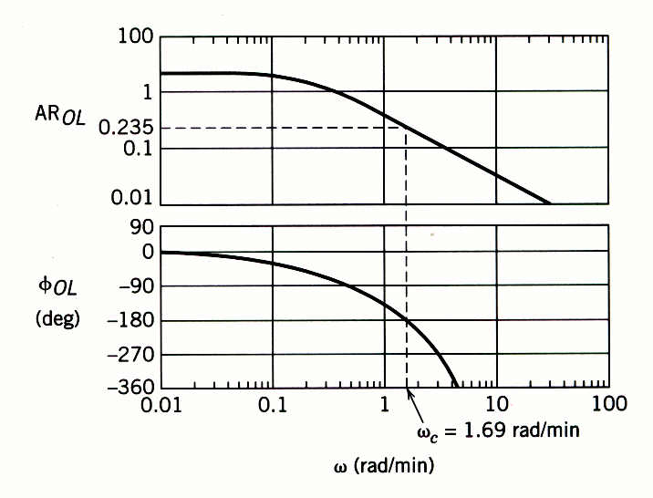
Solution
The Bode plot for G_{OL} and K_{c} = 1 is shown in Figure 14.7. For ω_{c} = 1.69 rad/min, φ_{OL} = -180° and AR_{OL} = 0.235. For K_{c} = 1, AR_{OL} = AR_{G} and K_{cu} can be calculated from Eq. 14-10. Thus, K_{cu} = 1/0.235 = 4.25. Setting K_{c} = 1.5K_{cu} gives K_{c} = 6.38.
Figure 14.7 Bode plot for Example 14.6, K_{c} = 1.

Slide 5
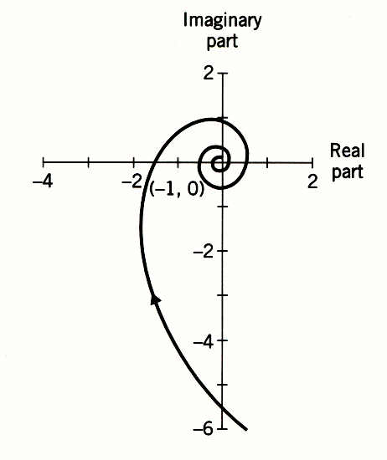
Figure 14.8 Nyquist plot for Example 14.6, K_{c} = 1.5K_{cu} = 6.38.

Slide 6

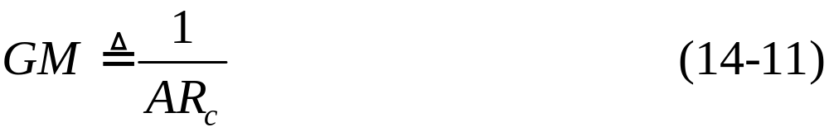


Gain and Phase Margins
Let AR_{c} be the value of the open-loop amplitude ratio at the critical frequency . Gain margin GM is defined as:
Phase margin PM is defined as
The phase margin also provides a measure of relative stability.
In particular, it indicates how much additional time delay can be included in the feedback loop before instability will occur.
Denote the additional time delay as .
For a time delay of , the phase angle is .

Slide 7
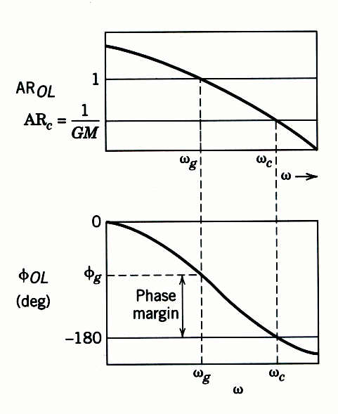
Figure 14.9 Gain and phase margins in Bode plot.

Slide 8
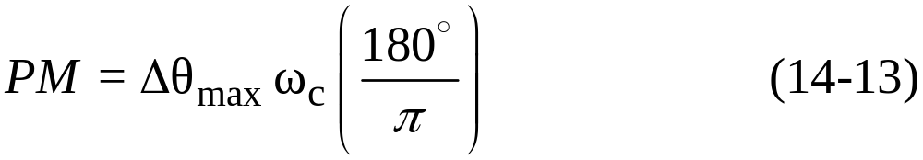
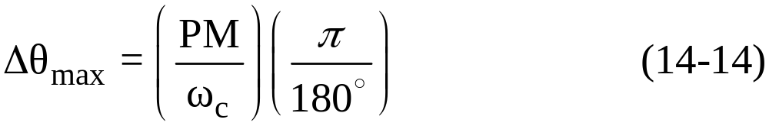
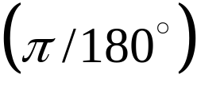
or
where the factor converts PM from degrees to radians.
The specification of phase and gain margins requires a compromise between performance and robustness.
In general, large values of GM and PM correspond to sluggish closed-loop responses, while smaller values result in less sluggish, more oscillatory responses.
Guideline. In general, a well-tuned controller should have a gain margin between 1.7 and 4.0 and a phase margin between 30° and 45°.

Slide 9
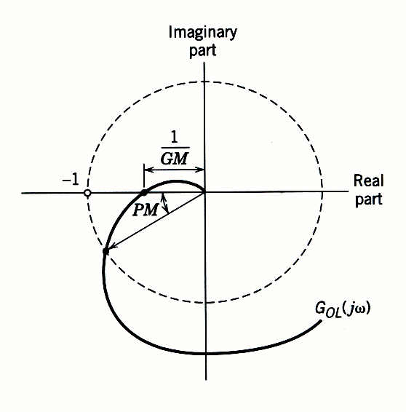
Figure 14.10 Gain and phase margins on a Nyquist plot.

Slide 10
Recognize that these ranges are approximate and that it may not be possible to choose PI or PID controller settings that result in specified GM and PM values.
Example 14.7
For the FOPTD model of Example 14.6, calculate the PID controller settings for the two tuning relations in Table 12.6:
Ziegler-Nichols
Tyreus-Luyben
Assume that the two PID controllers are implemented in the parallel form with a derivative filter (α = 0.1). Plot the open-loop Bode diagram and determine the gain and phase margins for each controller.

Slide 11
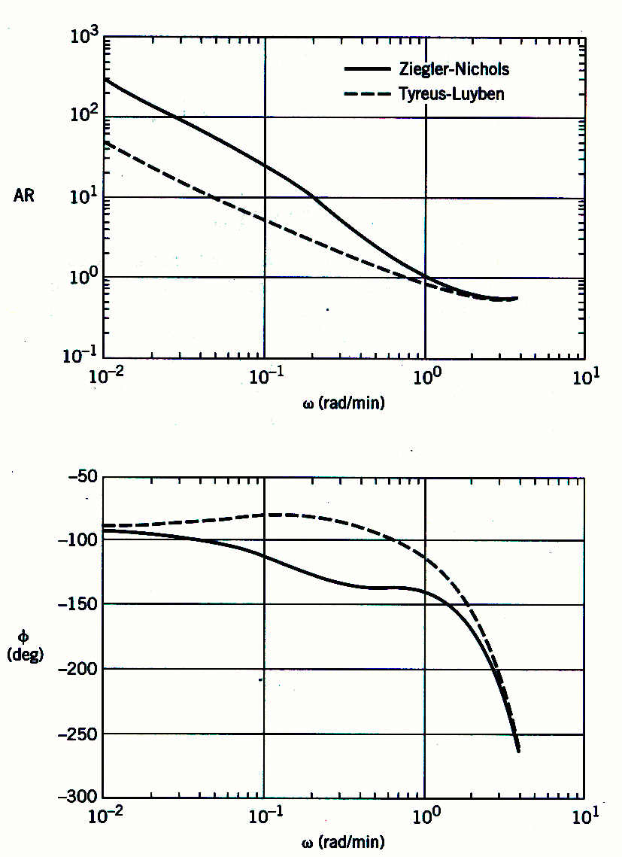
Figure 14.11 Comparison of G_{OL} Bode plots for Example 14.7.

Slide 12



For the Tyreus-Luyben settings, determine the maximum increase in the time delay that can occur while still maintaining closed-loop stability.
Solution
From Example 14.6, the ultimate gain is K_{cu} = 4.25 and the ultimate period is P_{u} = . Therefore, the PID controllers have the following settings:
Controller Settings | K_{c} | (min) | (min)
Ziegler-Nichols | 2.55 | 1.86 | 0.46
Tyreus-Luyben | 1.91 | 8.27 | 0.59

Slide 13
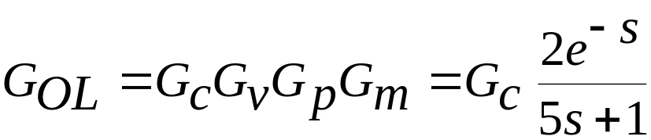
The open-loop transfer function is:
Figure 14.11 shows the frequency response of G_{OL} for the two controllers. The gain and phase margins can be determined by inspection of the Bode diagram or by using the MATLAB command, margin.
Controller | GM | PM | ω_{c} (rad/min)
Ziegler-Nichols | 1.6 | 40° | 1.02
Tyreus-Luyben | 1.8 | 76° | 0.79

Slide 14
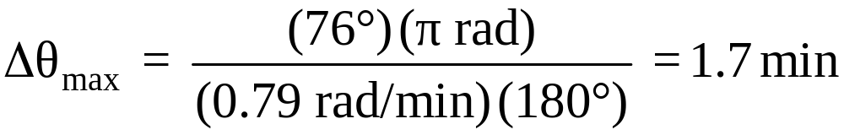

The Tyreus-Luyben controller settings are more conservative owing to the larger gain and phase margins. The value of is calculated from Eq. (14-14) and the information in the above table:
Thus, time delay can increase by as much as 70% and still maintain closed-loop stability.

Slide 15
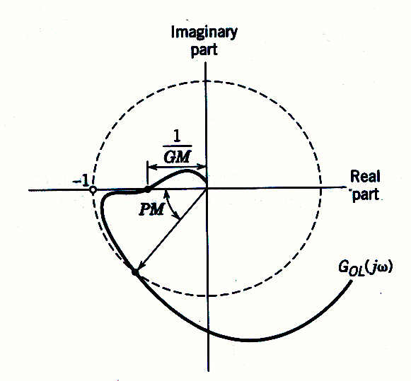
Figure 14.12 Nyquist plot where the gain and phase margins are misleading.

